Slide 1



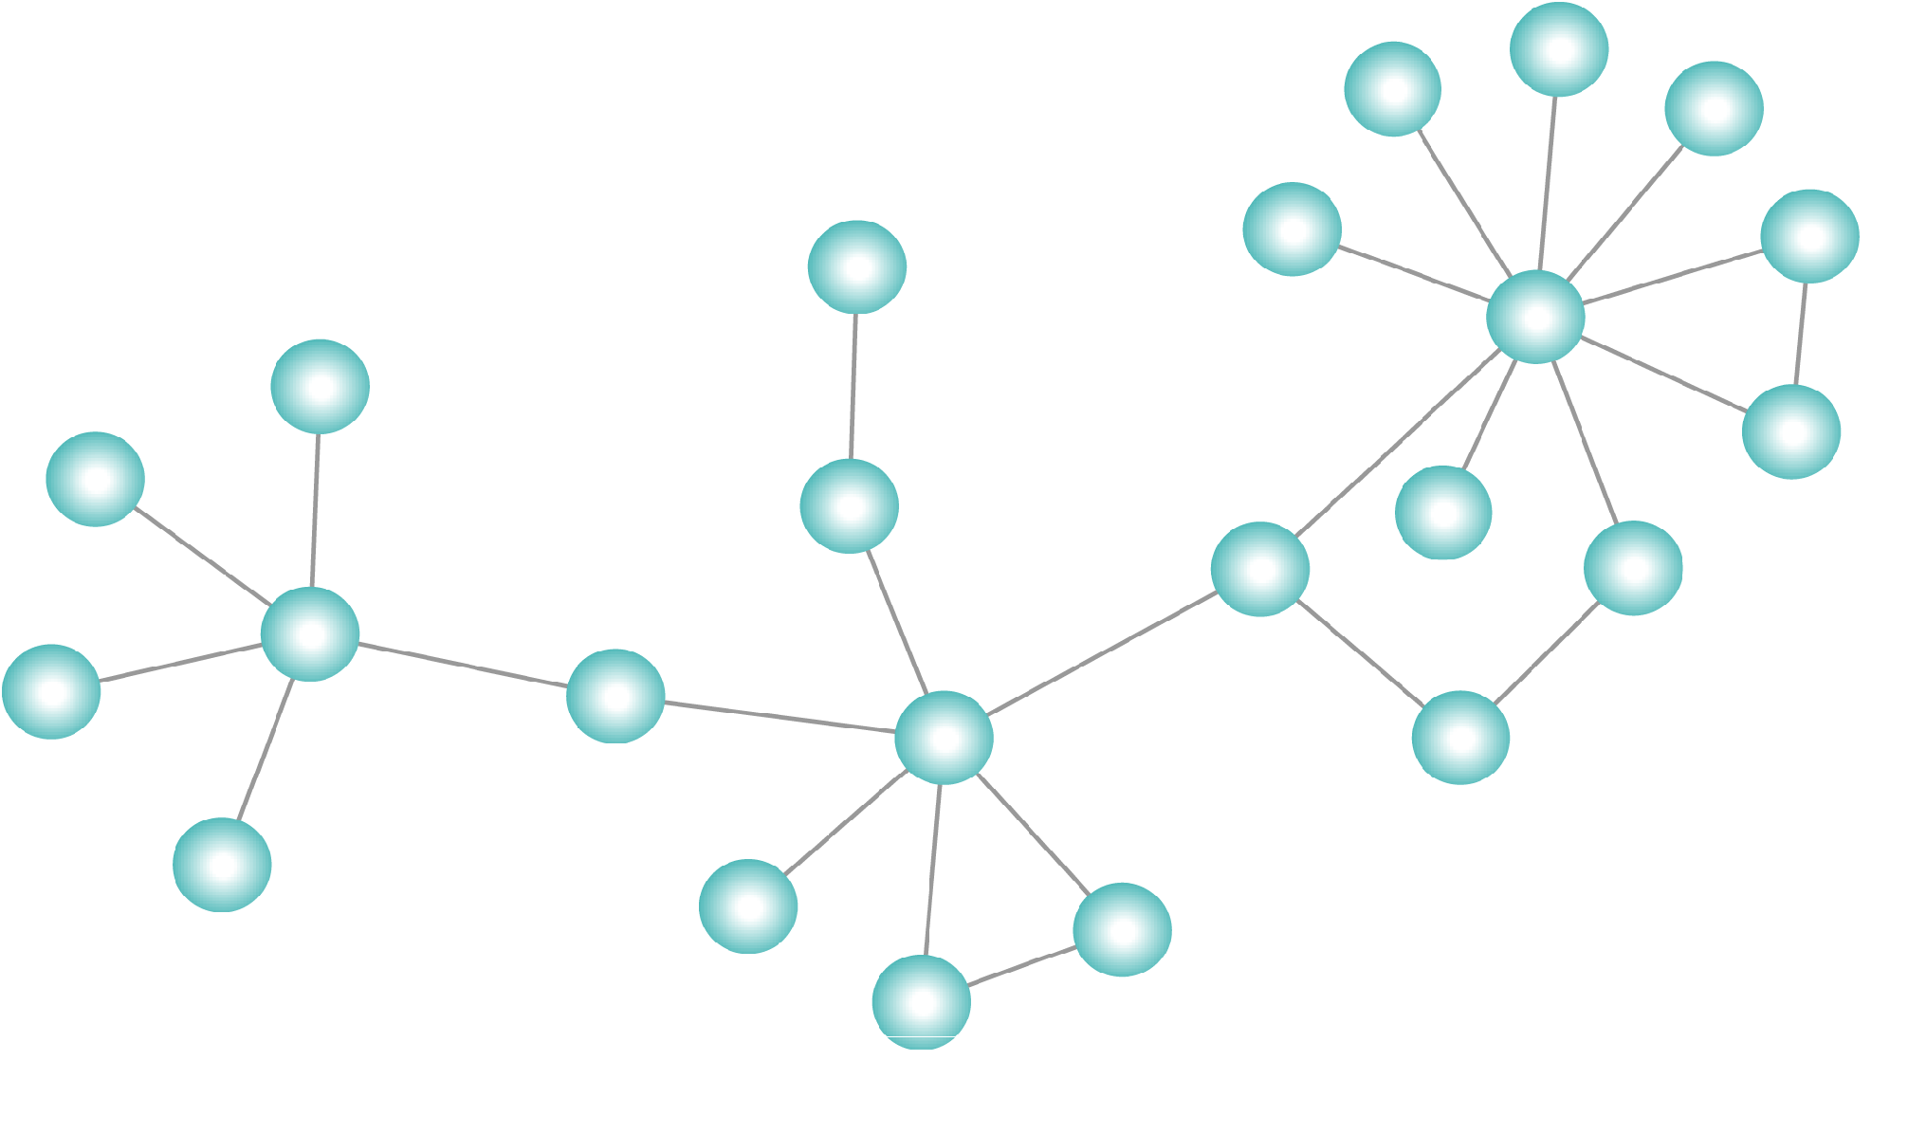
Maintaining sliding-window neighborhood profiles in interaction networks
Rohit Kumar, Toon Calders, Aristides Gionis, and Nikolaj Tatti

Slide 2
Outline
Problem statement
Our contribution
Experiments
Conclusion and future work

Slide 3
Interaction Network/Graph
An interaction network is defined as a sequence of timestamped
interactions є over edges of a static graph G = (V,E).
For example
Social interaction in social network.
Email/ Message or call interaction in communication network.
Data exchange between computer network.
Problem Statement
Contribution
Experiments
Conclusion and Future work
ECML/PKDD 2015

Slide 4


Example
5
d
e
1
4
2
,8
a
7
3
,6
b
c
1, (a , e)
2, (d, c)
3, (b , c)
4, (e , c)
5, (a , d)
6, (b , c)
7, (a , c)
8, (d , c)
. . . .
Problem Statement
Contribution
Experiments
Conclusion and Future work

Slide 5
Query: How many nodes are within distance r from node v at time t?
We call it Neighborhood profile of a node!
For example How many nodes within distance 2 from a at different time t
Node a | r = 1 |  | r = 2
t=3 | 1 | b | 1 | d
1
b
a
2
c
d
3
e
Problem Statement
Contribution
Experiments
Conclusion and Future work

Slide 6
Query: How many nodes are within distance r from node v at time t?
We call it Neighborhood profile of a node!
For example How many nodes within distance 2 from a at different time t
Node a | r = 1 |  | r = 2
t=3 | 1 | b | 1 | d
t=5 | 2 | c, b | 2 | d, e
1
b
a
5
2
c
d
3
4
e
Problem Statement
Contribution
Experiments
Conclusion and Future work

Slide 7
Query: How many nodes are within distance r from node v at time t?
We call it Neighborhood profile of a node!
For example How many nodes within distance 2 from a at different time t
Node a | r = 1 |  | r = 2
t=3 | 1 | b | 1 | d
t=5 | 2 | c, b | 2 | d, e
t=7 | 4 | c, e, d, b | 0 | -
1
b
a
5
2
6
c
d
7
3
4
e
Problem Statement
Contribution
Experiments
Conclusion and Future work

Slide 8
Query: How many nodes are within distance r from node v at time t?
We call it Neighborhood profile of a node!
For example How many nodes within distance 2 from a at different time t
Node a | r = 1 |  | r = 2
t=3 | 1 | b | 1 | d
t=5 | 2 | c, b | 2 | d, e
t=7 | 4 | c, e, d, b | 0 | -
t=10 | 4 | c, e, d, b | 0 | -
1
, 8
b
a
5
, 10
2
6
c
d
7
3
4
, 9
e
Problem Statement
Contribution
Experiments
Conclusion and Future work

Slide 9
Neighborhood profile in sliding window
a
1
b
Node a | r = 1 |  | r = 2
t=5 | 2 | c, b | 2 | d, e
5
2
c
d
3
4
e
Current data in window
Future edges
1, (a , b)
2, (b, d)
3, (c , e)
4, (e , d)
5, (a , c)
6, (b , c)
7, (a , c)
Consider a window length of size 5.
Problem Statement
Contribution
Experiments
Conclusion and Future work

Slide 10
Neighborhood profile in sliding window
a
b
Node a | r = 1 |  | r = 2
t=5 | 2 | c, b | 2 | d, e
t=6 | 2 | c, d | 1 | e
5
2
6
c
d
3
4
e
Expired edges
Current data in window
Future edges
1, (a , e)
2, (d, c)
3, (b , c)
4, (e , c)
5, (a , d)
6, (b , c)
7, (a , c) ………..
Consider a window length of size 5.
Problem Statement
Contribution
Experiments
Conclusion and Future work

Slide 11
Neighborhood profile in sliding window
a
b
Node a | r = 1 |  | r = 2
t=5 | 2 | c, b | 2 | d, e
t=6 | 2 | c, d | 1 | e
t=7 | 3 | c, d, e | 0 | -
5
6
c
7
d
3
4
e
Expired edges
Current data in window
Future edges
1, (a , e)
2, (d, c)
3, (b , c)
4, (e , c)
5, (a , d)
6, (b , c)
7, (a , c) ………..
Consider a window length of size 5.
Problem Statement
Contribution
Experiments
Conclusion and Future work

Slide 12
Existing Solution's Limitations
Multi pass algorithm.
Considers a static graph (every edge has same importance); no sliding window.
Need to rerun for each time window.
Can not be parallelized.
Problem Statement
Contribution
Experiments
Conclusion and Future work

Slide 13
We propose an online Algorithm
We develop and analyze an exact online but memory inefficient streaming algorithm.
We extend the algorithm to an approximate memory-efficient streaming algorithm for sliding window model.
We provide experimental validation of the algorithms.
Both algorithms are easily parallelizable.
Problem Statement
Contribution
Experiments
Conclusion and Future work

Slide 14
Path Horizon and Promising Path
Path horizon: timestamp of the oldest edge on the path
Path exists in a window if its horizon is in the time window
v₀
v₁
v₂
v₃
v₄
Horizon = 1
3
1
2
5
v₀
v₁
v₂
v₃
v₄
Horizon = 2
3
1,6
2
5,7
Problem Statement
Contribution
Experiments
Conclusion and Future work

Slide 15
Path Horizon and Promising Path
Promising path = path that is or still can become a shortest path
Path between a and b is promising if all other shorter paths between a and b have smaller horizon.
a
v₂
v₃
b
1
2
5
6
10
v'₁
v'₂
v'₃
8
4
Problem Statement
Contribution
Experiments
Conclusion and Future work
ECML/PKDD 2015

Slide 16
Path Horizon and Promising Path
Promising path = path that is or still can become a shortest path
Path between a and b is promising if all other shorter paths between a and b have smaller horizon.
a
v₂
v₃
b
2
5
6
10
v'₁
v'₂
v'₃
8
4
Contribution
Experiments
Conclusion and Future work
Problem Statement
ECML/PKDD 2015

Slide 17
Algorithm
Based on maintaining summaries of nodes at distances 1..r by keeping track of promising paths of length less than or equal to r.
And a simple observation that change in summary at distance i for a node u will introduce a change in all of its neighbor’s summary at distance i+1.i.e
If S^{u}[i] of node u changes it propagates this change to its neighbors as:
S^{v}[i+1] = S^{v}[i+1].merge(S^{u}[i]) ∀ v є Neighbor of u
The merge will only add new promising paths and remove old ones.
Problem Statement
Contribution
Experiments
Conclusion and Future work
ECML/PKDD 2015

Slide 18
For every node u: maintain summary S^{u}_{t} = (S^{u}_{t} [1],...., S^{u}_{t} [r]), where S^{u}_{t}[i] = { (v,h | ∃ promising path of length i and horizon h between u and v}.
Sª₅[1]={(b,1),(c,5)}
Sª₅[2]={(d,1),(e,3)}
Sª₅[3]={(d,3)}
a
1
b
5
2
c
d
S^{d}₅[1]={(b,2),(e,4)}
S^{d}₅[2]={(a,1),(c,3)}
3
4
Sª₅[3]={(a,3)}
e
←
Problem Statement
Contribution
Experiments
Conclusion and Future work
→

Slide 19
For window length 3 at time stamp 5 if we query for node a
to get #Nodes within distance 3 = count(merge(S[1],S[2],S[3]))=3
Sª₅[1]={(b,1),(c,5)}
Sª₅[2]={(d,1),(e,3)}
Sª₅[3]={(d,3)}
a
1
b
5
2
c
d
S^{d}₅[1]={(b,2),(e,4)}
S^{d}₅[2]={(a,1),(c,3)}
3
4
Sª₅[3]={(a,3)}
e
←
Problem Statement
Contribution
Experiments
Conclusion and Future work
→

Slide 20
For window length 5 at time stamp 5 if we query for node a
to get #Nodes within distance 3 = count(merge(S[1],S[2],S[3]))=4
Sª₅[1]={(b,1),(c,5)}
Sª₅[2]={(d,1),(e,3)}
Sª₅[3]={(d,3)}
a
1
b
5
2
c
d
S^{d}₅[1]={(b,2),(e,4)}
S^{d}₅[2]={(a,1),(c,3)}
3
4
Sª₅[3]={(a,3)}
e
←
Problem Statement
Contribution
Experiments
Conclusion and Future work
→

Slide 21
The intuition behind the algorithm on how to update the summary when a new edge arrives
Sª₆[1] = (b,1),(c,5)
,(d,6)
S^{b}₆[1] = (a,1),(d,2)
Sª₆[2] = (d,1),(e,3)
,(b,2)
,(e,4)
S^{b}₆[2] = (e,2),(c,1)
(a,2)
(d,1)
Sª₆[3] = (d,3)
a
1
b
S^{b}₆[3] = (c,2)
5
2
6
S^{c}₆[1] = (a,5),(e,3)
c
d
S^{c}₆[2] = (b,1),(d,3)
(d,5)
S^{d}₆[1] = (b,2),(e,4)
,(a,6)
S^{c}₆[3] = (b,2)
,(e,4)
3
4
S^{d}₆[2] = (a,1),(c,3)
,(c,5)
e
S^{b}₆[3] = (a,3)
S^{e}₆[1] = (d,4),(c,3)
S^{e}₆[2] = (a,3),(b,2)
,(a,4)
S^{e}₆[3] =
(c,4)
←
Problem Statement
Contribution
Experiments
Conclusion and Future work
→

Slide 22
Computational Complexity
Let n= |V| , m =|E| and r be the upper bound on the distances we are maintaining
The exact algorithm has
Time complexity: O(rmnlog(n))
Space complexity: O(rn²)
Quadratic dependence on number of nodes not acceptable for large graphs
Hence approximate algorithm
Problem Statement
Contribution
Experiments
Conclusion and Future work
ECML/PKDD 2015

Slide 23
Approximations
We are not interested in actual nodes in the summary but just want a distinct count of the nodes in the summary.
We just want the association property of set to be supported to do merge.
We can use any approximate distinct counting sketch which supports association.
Problem Statement
Contribution
Experiments
Conclusion and Future work
ECML/PKDD 2015

Slide 24
HyperLogLog Sketch (Philippe Flajolet, Éric Fusy, Olivier Gandouet and Frédéric Meunier)
HLL sketch = vector of size 2^{k}
Initialize to all 0
When item x arrives:
Compute hash h(x)
Take last k bits of h(x) → index of counter that will be updated
Take all bits except last k → V
Take the number of trailing 0’s in V, add 1 = value
If value > HLL[index], then update HLL[index]
Estimate: based on principle that having z trailing zeros has a probability of 2^{z+1} as estimate = constant * k²*(
Problem Statement
Contribution
Experiments
Conclusion and Future work

Slide 25
HyperLogLog Sketch
EXAMPLE: k=4
x arrives; h(x) = b 10101001100 1000
index = b 1000 = 8
number of 0’s = 2 → value = 3
update cell HLL[8] with value 3
0 | 0 | 0 | 0 | 0 | 0 | 0 | 0 | 0 | 0 | 0 | 0 | 0 | 0 | 0 | 0
Problem Statement
Contribution
Experiments
Conclusion and Future work

Slide 26
HyperLogLog Sketch
EXAMPLE: k=4
x arrives; h(x) = b 10101001100 1000
index = b 1000 = 8
number of 0’s = 2 → value = 3
update cell HLL[8] with value 3
0 | 0 | 0 | 0 | 0 | 0 | 0 | 3 | 0 | 0 | 0 | 0 | 0 | 0 | 0 | 0
Problem Statement
Contribution
Experiments
Conclusion and Future work

Slide 27
HyperLogLog Sketch
EXAMPLE: k=4
y arrives; h(y) = b 10101000010 1010
index = b 1010 = 10
number of 0’s = 1 → value = 2
update cell HLL[10] with value 2
0 | 0 | 0 | 0 | 0 | 0 | 0 | 3 | 0 | 2 | 0 | 0 | 0 | 0 | 0 | 0
Problem Statement
Contribution
Experiments
Conclusion and Future work

Slide 28
Sliding HyperLoglog Sketch (Yousra Chabchoub, Georges Hebrail)
Extension to the HLL sketch to allow for sliding window queries
In the window of the last w items, how many different items were there?
Maintain a list of Future Possible Maxima (LFPM) for each bucket of the HLL sketch:
t1,5
t5,3
t7,1
t2,10
t3,7
t8,1
t4,6
t6,3
t6,2
…
…
…
…
…
…
Problem Statement
Contribution
Experiments
Conclusion and Future work

Slide 29
Sliding HyperLoglog Sketch
Extension to the HLL sketch to allow for sliding window queries
In the window of the last w items, how many different items were there?
Maintain a list of Future Possible Maxima (LFPM) for each bucket of the HLL sketch:
t1,5
t5,3
t7,1
t9,4
t2,10
t3,7
t8,1
t4,6
t6,3
t6,2
…
…
…
…
…
…
Problem Statement
Contribution
Experiments
Conclusion and Future work

Slide 30
Sliding HyperLoglog Sketch
Extension to the HLL sketch to allow for sliding window queries
In the window of the last w items, how many different items were there?
Maintain a list of Future Possible Maxima (LFPM) for each bucket of the HLL sketch:
t1,5
t5,3
t7,1
t9,4
t2,10
t3,7
t8,1
t4,6
t6,3
t6,2
…
…
…
…
…
…
Problem Statement
Contribution
Experiments
Conclusion and Future work

Slide 31
Sliding HyperLoglog Sketch
Extension to the HLL sketch to allow for sliding window queries
In the window of the last w items, how many different items were there?
Maintain a list of Future Possible Maxima (LFPM) for each bucket of the HLL sketch:
Expected size: logarithmic
t1,5
t9,4
t2,10
t3,7
t8,1
t4,6
t6,3
t6,2
…
…
…
…
…
…
Problem Statement
Contribution
Experiments
Conclusion and Future work

Slide 32
Approximate algorithm
Sliding HyperLogLog sketch : extension of HyperLogLog to maintain a distinct set counter over sliding window.
If number of buckets in the HLL counter is k then the worst case complexity changes to:
The time complexity :
O(r m n log(n)) changes to O(r m 2^{k}loglog(n))
The space complexity :
O(r n²) changes to O(r n2^{k}loglog(n))
K ~ 7
Problem Statement
Contribution
Experiments
Conclusion and Future work

Slide 33
Average Relative Error
Dataset | #Nodes | #distinct Edges | #Interactions | Clustering Coefficient | Effective Diameter | Average Rel Error(k=7
Facebook | 4,039 | 88,234 | 88,234 | 0.60 | 4.7 | 0.08
Cit-HepTh | 27,771 | 352,801 | 352,801 | 0.31 | 5.3 | 0.10
Higgs | 166,840 | 249,030 | 500,000 | 0.19 | 4.7 | 0.14
DBLP | 192,357 | 400,000 | 800,000 | 0.63 | 8 | 0.09
*Data source - https://snap.stanford.edu/data/links.html
Problem Statement
Contribution
Experiments
Conclusion and Future work

Slide 34
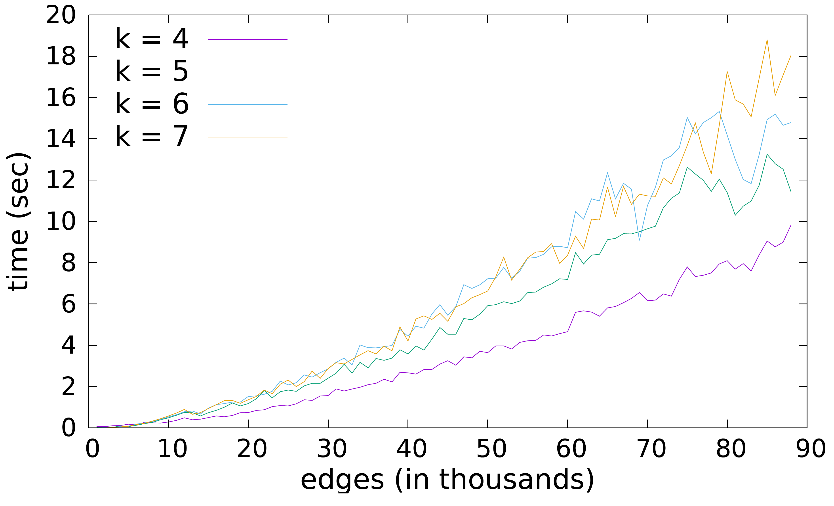
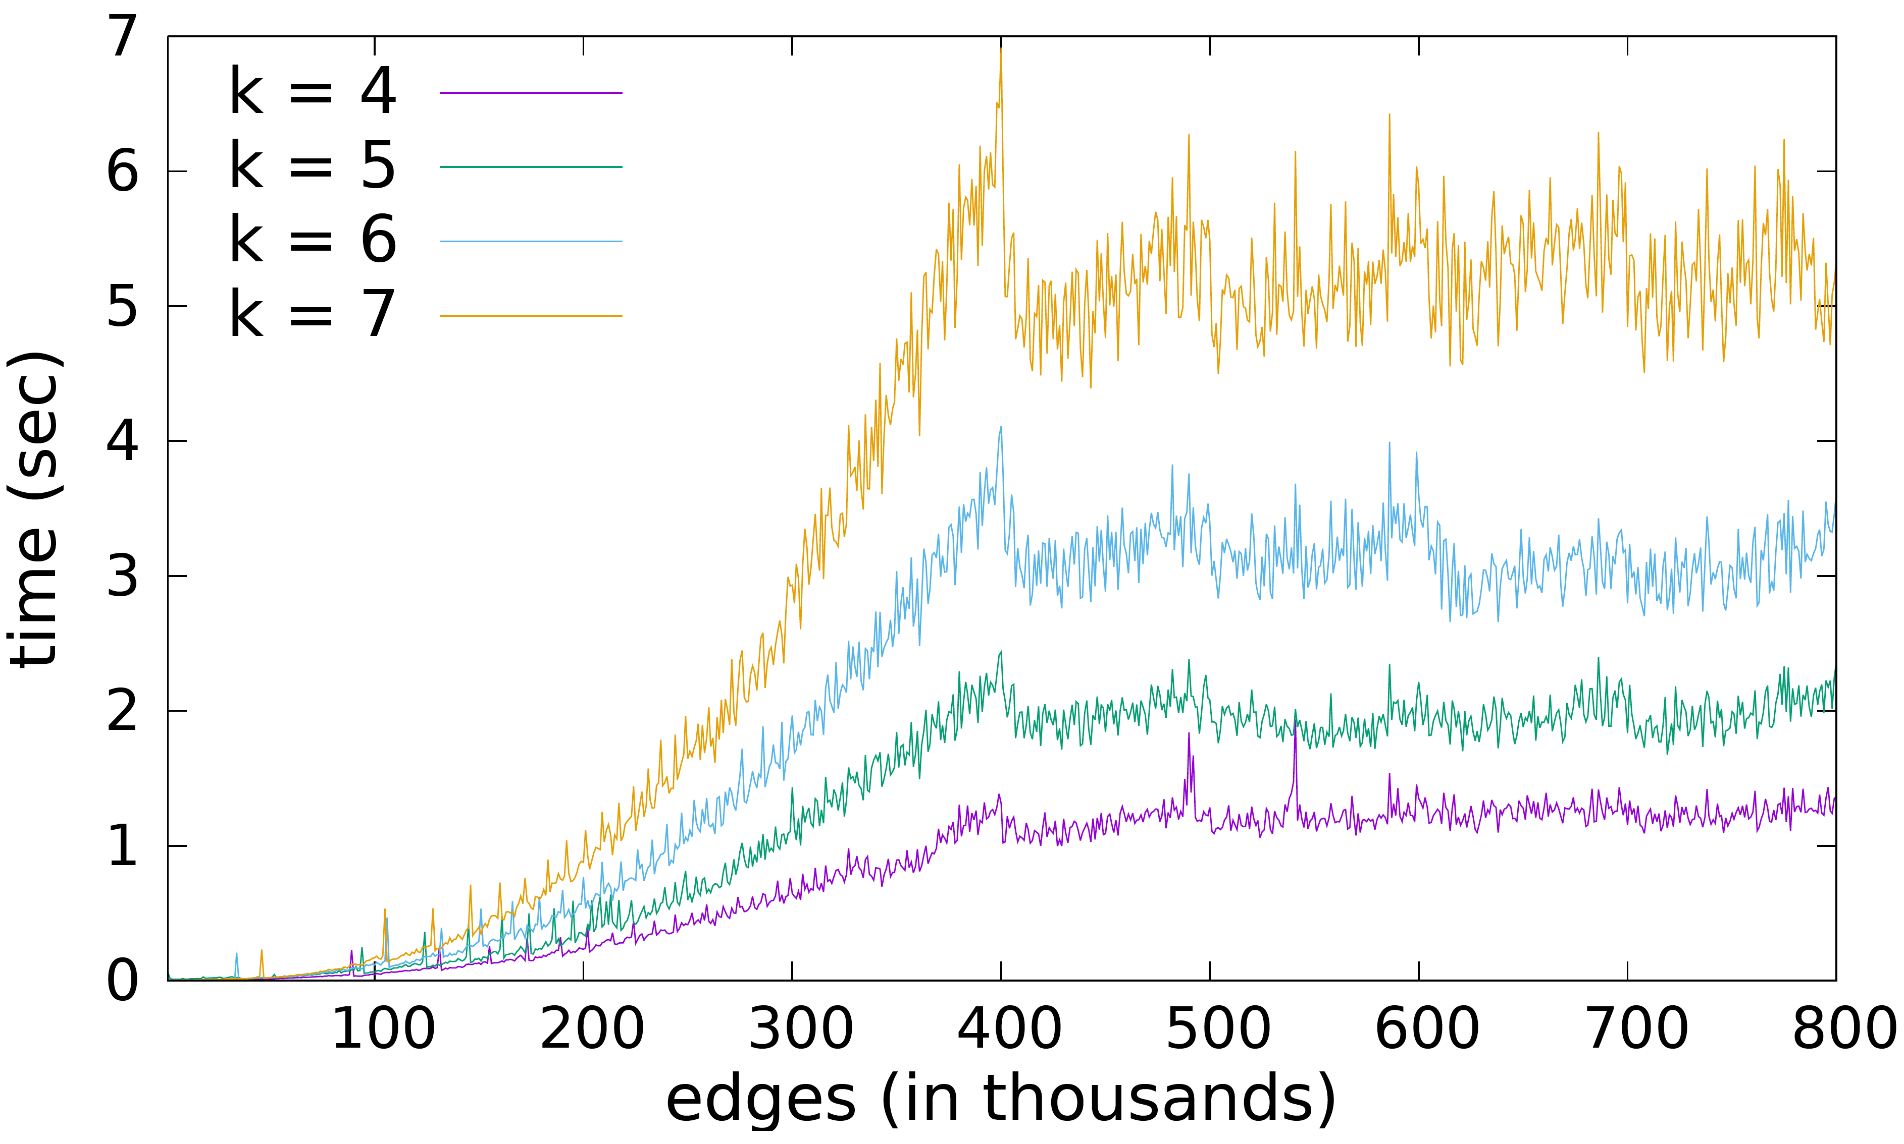
Average time(sec) to process 1000 edges at different k.
Facebook
DBLP
Problem Statement
Contribution
Experiments
Conclusion and Future work

Slide 35
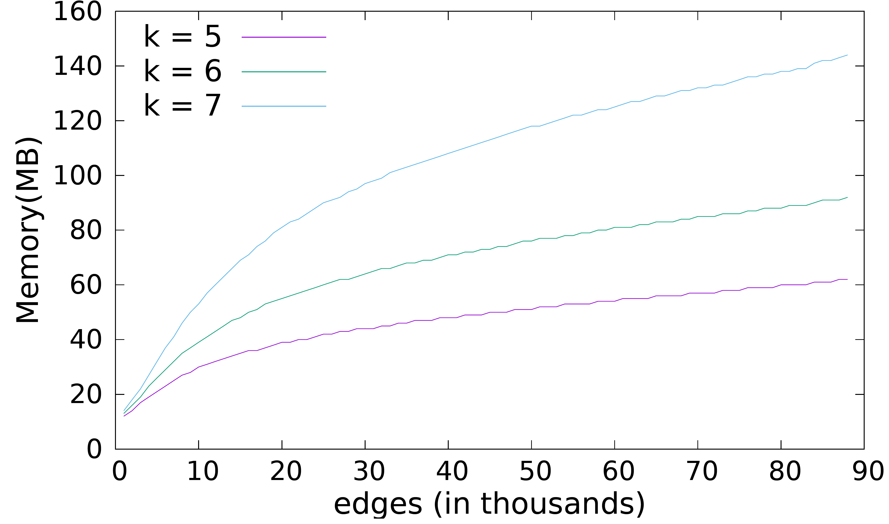
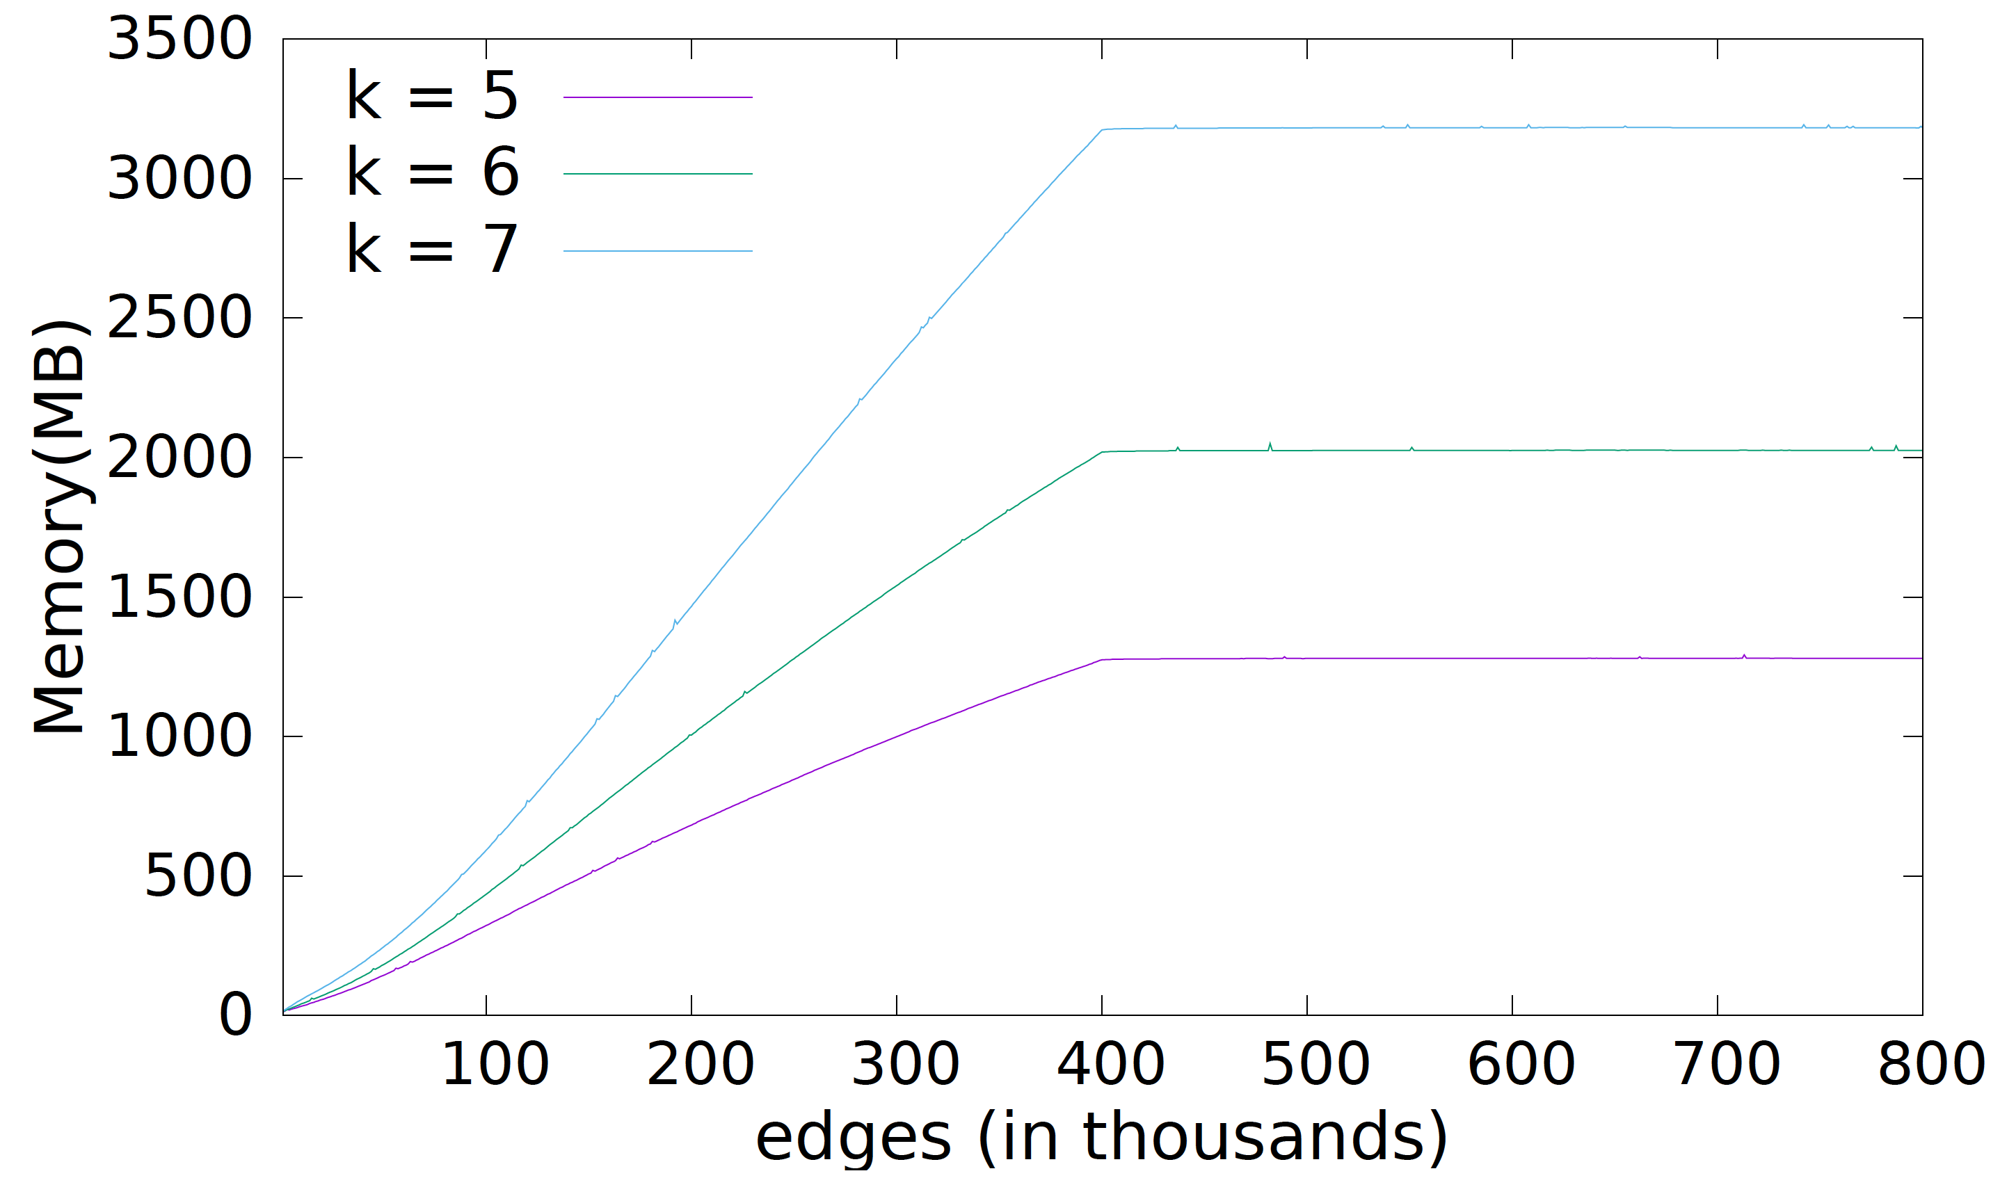
Average memory(Mb) to process 1000 edges at different k.
Facebook
DBLP
Problem Statement
Contribution
Experiments
Conclusion and Future work

Slide 36
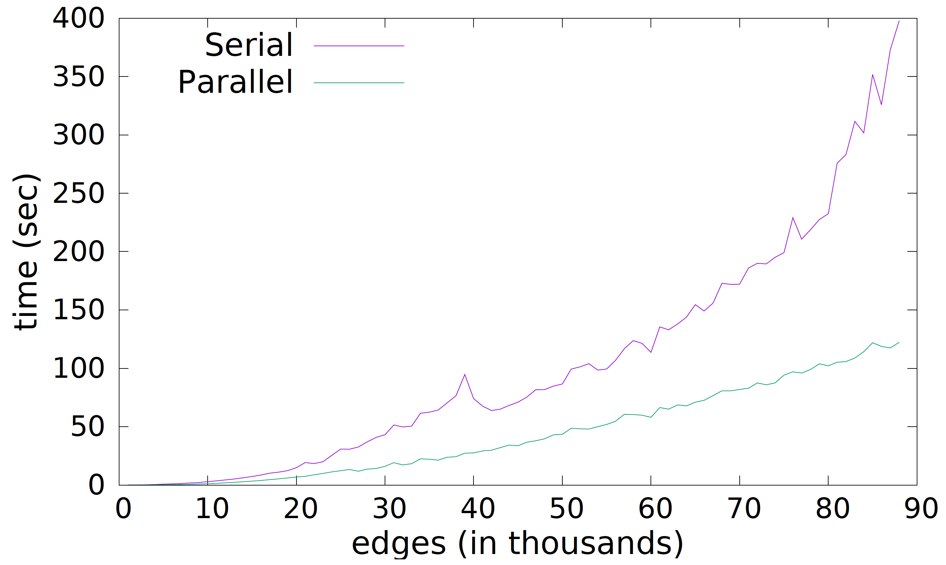
Effect of parallelization on running time on DBLP data set
4 threads in parallel
Problem Statement
Contribution
Experiments
Conclusion and Future work

Slide 37
Conclusion
The first online algorithm for efficiently querying Neighborhood profiles in interaction networks.
Theoretical worst case bounds for both the exact and approximate algorithm.
Experimental validation of the model shows promising results.
Parallel implementation under a share everything model.
Problem Statement
Contribution
Experiments
Conclusion and Future work

Slide 38
Future Work
Implementation using Pregel Model (either Giraph or GraphX)
Using Neighborhood profile to find spam web pages.
Using Neighborhood profile for anomaly detection/attack in a network.
Problem Statement
Contribution
Experiments
Conclusion and Future work

Slide 39
Thank you!

Slide 41
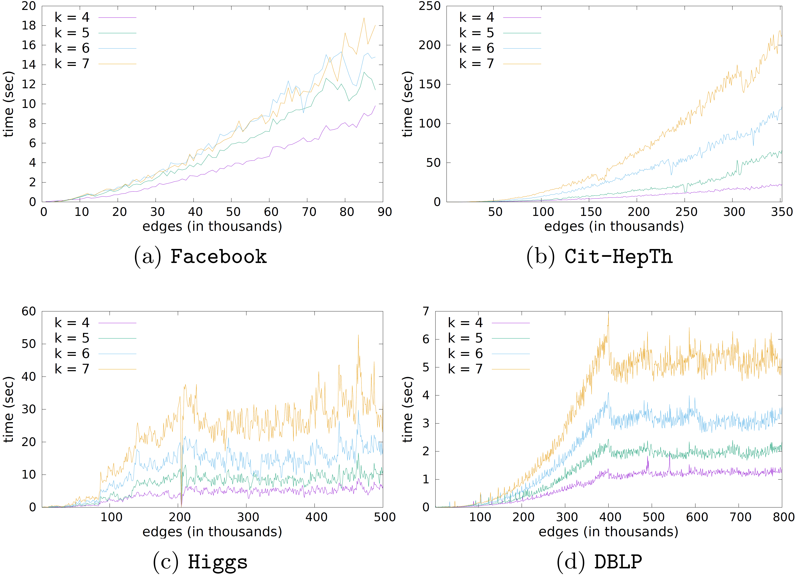
Average time(sec) to process 1000 edges at different k.
Problem Statement
Contribution
Experiments
Conclusion and Future work

Slide 42
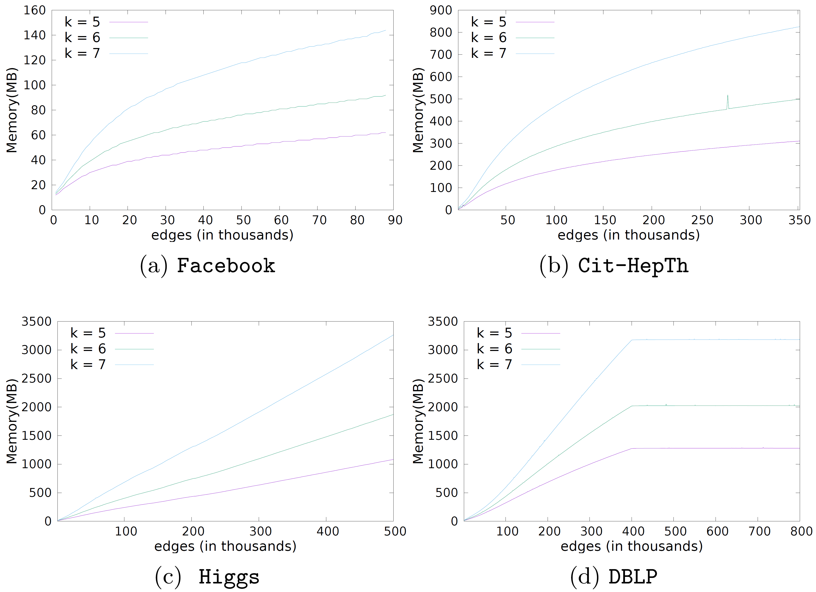
Average memory(Mb) to process 1000 edges at different k.
Problem Statement
Contribution
Experiments
Conclusion and Future work

